Slide 1

Data Visualisations Using Python And Matplotlib
Contents
-Line Chart
-Advanced Line Chart
-Dotted Line Chart
-Scatter Chart
-Multiple Bar Chart
-Bar Chart
-Histogram
-Subplots Chart
-Pie Chart
-Stack Plot Chart

Slide 2
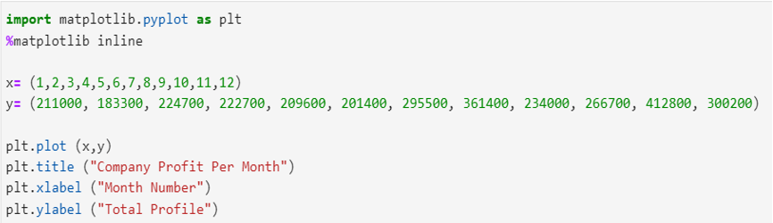
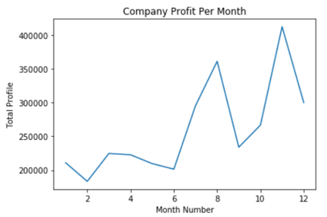
Line Chart
Import matplotlib.pyplot as plt %matplotlib inline is used at the beginning of each chart as it summons the programme used to construct the charts. Furthermore every time plt is called it accesses a function which calls upon any tool needed in the creation of a chart.
This first graphic is the most simple of graphics, a simple line chart. First we define the X variable which iterates by one representing each month of the year. The Y variable is the total profit throughout the whole year, and again has twelve values representing each month of the year. plt.plot identifies the variables to include in the graph which in this case is just two. Titles and labels are then defined which labels the X and Y axis, as well as giving the chart a title.
From this graphic a company can gain a visual perspective of their financial performance over a year. They can gain insight into which months are most rewarding and base marketing/ promotions campaigns and other strategies depending on the conditions of each month. From this particular chart its clear that the first six months are slow followed by a huge spike over the next two months, there may be a reason for this but from an analytical perspective it could be more sustainable to have steady positive growth over the year rather than radical spikes, this helps from a cash flow and a forecasting perspective.

Slide 3
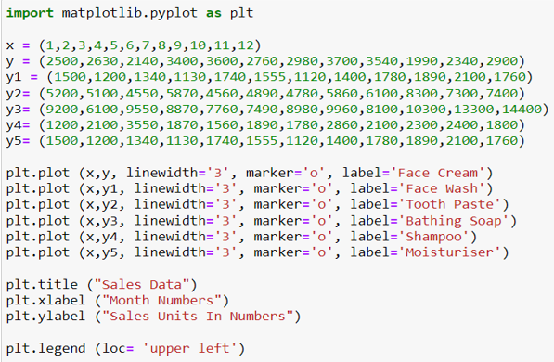
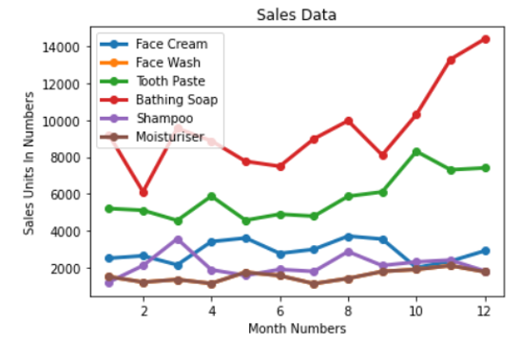
Advanced Line Chart
This second graph is an advanced version of the previous chart. The X variable is the same being months, however there are many different variables in the Y section, each of these representing different products sales data. Multiple plt.plot are identified each using X and the retrospective Y needed for each individual line. The lines are then formatted with line width, marker and then they were each labelled individually so we know which line represents each product. Furthermore titles and labels for the axis’s are made like previously. A legend is then constructed, essentially like a key where we can see the colours and titles of each line of data. We also instruct the legend to be the top left of the chart.
This visualisation is useful for a company as it compares each product along side each other and therefore gives an indication of the different performances. Those like moisturiser sell very few units compare to the high performance of bathing soap. We can also use this graphic to spot trends and therefore determine which performs in relation to the time of year, like previously suggested this can be beneficial to the marketing department but also it is important for the manufacturing aspect so the company can use this graph as a metric to predict what levels of stock to order/hold at each particular time. We must also note that this metric should be used in conjunction with others as there is clear disparity between units sold however that doesn't account for the price of each item, in another graph moisturiser could be the most profitable despite selling the least amount of units.

Slide 4
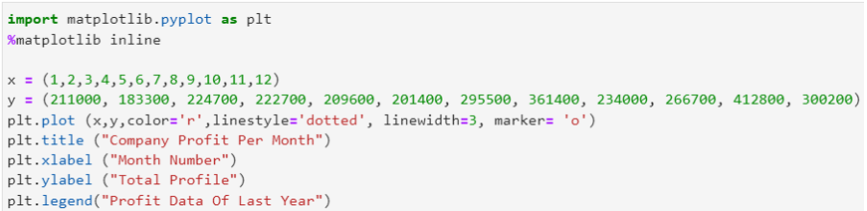
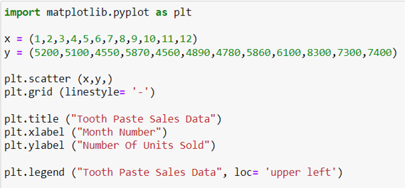
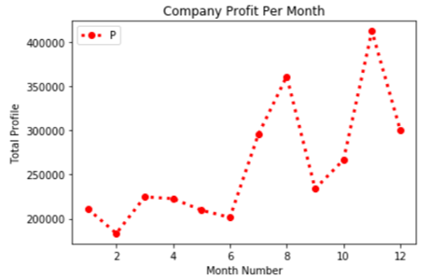
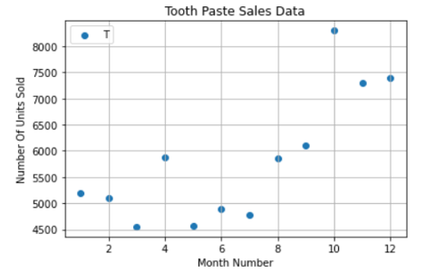
Dotted Line Chart/ Scatter Chart
This chart is a scatter chart in relation to tooth paste sales data. The X variable shows the month numbers and they Y variable is the sales data of tooth paste. Again, only X and Y are used is plt.scatter, we also use a grid over the chart so that the points have somewhere to sit on rather than be free floating. The chart is then given a title and the axis’s are labelled. A legend is also added with a location put to the top left corner.
This chart is created exactly the same as the first chart with the same variables. The difference is however that this chart has been formatted in more detail. This graph adds colour, line style, line width and a marker style, this added detail makes the graph more attractive to look out and the addition of markers make the graph stand out and allows for clearer interpretation. Furthermore this graph uses a legend titled profit data of last year.
This piece of data breaks down the bigger picture into a particular sub product. Such data gives us greater insight into each product and how it sells over the course of a year. The scatter shows that toothpaste sales are slow at the start of the year and then rapidly increases towards the end. This data can therefore be useful for the marketing and manufacturing department of a company to make decisions.

Slide 5
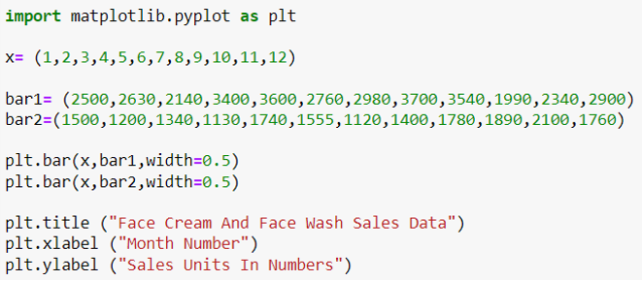
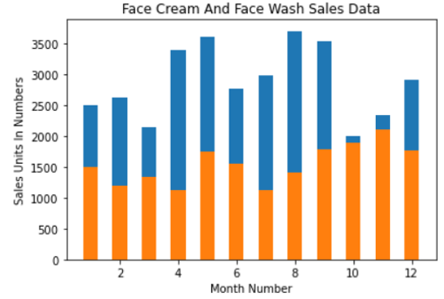
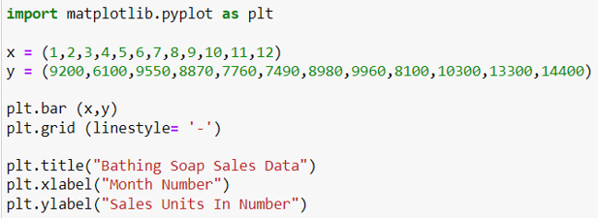
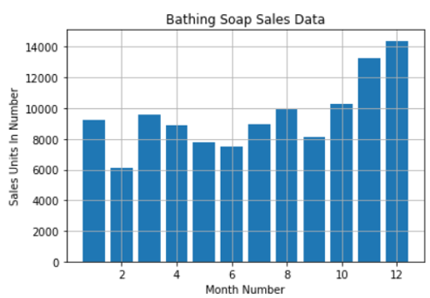
Multiple Bar Chart/Bar Chart
This chart is similar to the previous bar chart, however only takes into account one variable which is the bathing soap sales data. The way the chart was created is identical to the previous bar chart. Other features are however added, for example a different line style which appears like a grid.
This bar chart breaks down the specific product of bathing soap. The chart is relatively steady and shows similar sales numbers throughout the year baring February which is relatively lower than the average and November and December showing a drive towards the close of the year. The factors behind this are most likely seasonal as more people have baths in the colder seasons and bathing soap is most likely a popular gift option for Christmas. This data is useful so that stock levels are accounted for, for these periods.
Here we see the first example of a bar chart. The X variable as used previously represents the months in a year. However the Y variables are predefined as bar1 and bar2 these are assigned values from the sales data relating to face cream and wash. The plt.bar uses just the X variable as the bars must sit on the X axis. They are then assigned a bar width purely for presentation reasons. The axis’s and the title are then given names.
This data is represented in a manner where two products of similar description are compared against each other. The orange represents the face wash data which sits well below the high flying figures of the face wash data. Month by month the face wash product sells more units than the face cream data, this disparity closes however in October and November, from an analytical point of view this is a time to assess the variables as to why the disparity closes. Different qualitative factors could play a part into sales information such as the different seasons.

Slide 6
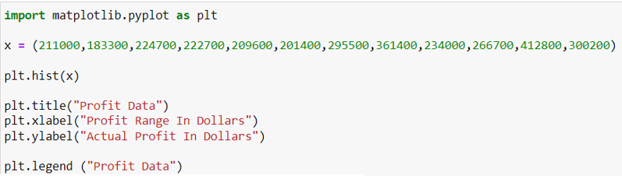
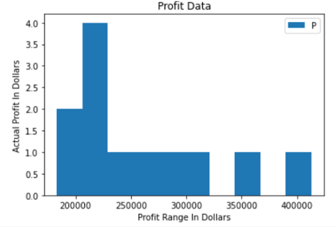
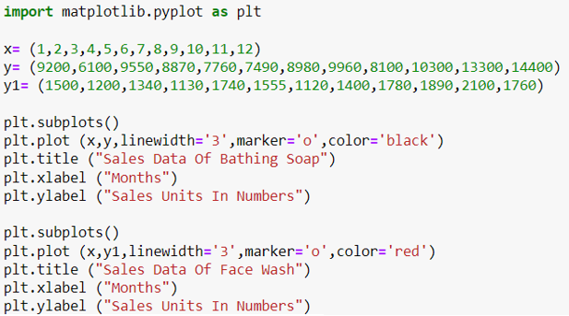
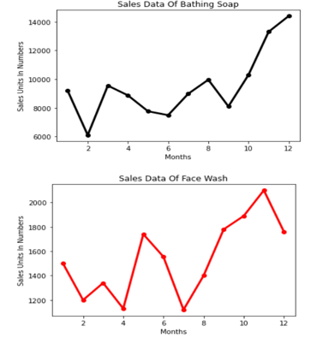
Histogram/Sub Plots Chart
Here a histogram is used for the first time. Unlike the previous charts this one only takes in one variable and doesn’t include months. This one variable is just the profit data. Therefore only plt.hist (x) was used. The axis’s and a title were both assigned as usual as well as a legend. The only variable being analysed here is just simple profit data.
The histogram looks similar to a bar chart with no gaps however it tells a different story. The profit range sits on the X axis and on the Y axis we see the actual profit per range. From a financial perspective we can see what the average profit range is, and to what amount of profit those ranges return. This graph would be useful for the financial department of a business so they can see where their profits lie and what can be done to increase profits in particular areas. For this data set the company may be satisfied with the results depending on what price they are assigning to each product, of course there is data that sits in the forty thousand so they may look to add actual profit to that range.
This subplot chart is essentially two line graphs side by side. Two separate subplots are made, they both use X however they have their own values for Y. Both are assigned their own line width, marker and colour and named accordingly to what they represent.
This chart is useful for comparing two products side by side, we have seen to products shown side by side previously however this example is very clear. What we can take from these charts is that they both show sharp inclines from the midway point up until the end of the year. This confirms the argument that sales are generally varied and only show clear correlation coming into the second half of the year. Perhaps from this data and previous charts we have created, the company needs to do more to boost sales in the first half of the year across all products.

Slide 7
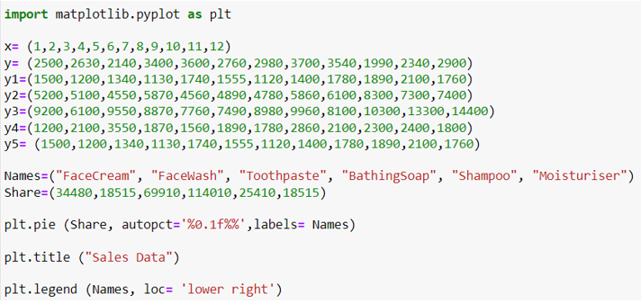
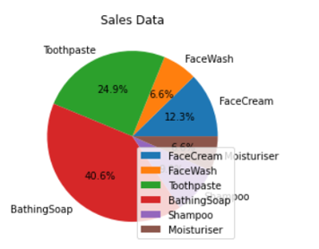
Pie Chart
A pie chart is introduced here, this is the most complex chart used so far. Each product variable is accounted for, however the sum() function was used on google sheets to add up each products entire sales data for they year, this giving us six total figures which are represented in the “Share” line. Names are also assigned to each share so that we know which product holds which share, this is later included as labels are assigned to name. The autopct provides us with a percentage and is shown on the labelling of the chart below. Much like the other charts a title and legend are applied to give clarity on what the data is, and about. Each product is then fitted into the chart depending on their overall sales data and what that is in relation to the other products available.
This graphic is a clear way to represent how many units of each product are sold. Bathing Soap is a clear popular one and surely the flag ship product for this company. A business can use such graph to gain insight into what product sells the best, having bathing soap as the best seller they may chose to keep pushing this product, they could do this by modifying it and giving them different flavours and scents, furthermore they may try to expand into different markets which could be age groups or locations. It is important to use this data with the actual profit margins for each product, from this graph one may think that the smallest share moisturiser is not a very popular product, however the price may be ten times that of bathing soap and have a much higher profit margin and therefore be a more profitable product. Having said that once the additional data is taken then we can figure out what would be the most optimal product to sell. It is important for a business to display data in a pie chart as it is the most clear way to represent data in a percentage form.

Slide 8
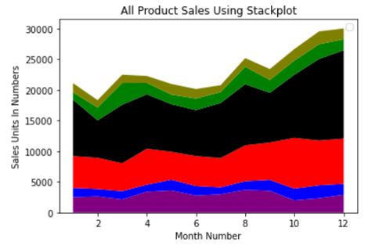
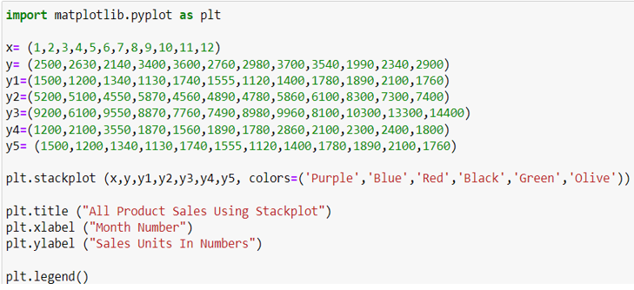
Stack Plot Chart
This stack plot shows all the sales data per month for each product. The X variable shows each separate month. From Y to Y5 represents the data for each of the different products and the their sales numbers for each month. plt.stackplot calls the X variable and all the Y variables together. Colour are then assigned to each variable depending on the specification colour. A title and the axis’s are then assigned names with a legend included. The graph is ordered as a cumulative sales number and each shaded area shows the proportion a specific product adds to the grand total, black clearly being the best selling of the lot.
Just like previous charts a business can use this data to gain insight into how many units of each product have been sold, the more shaded the plot is the more units are sold. The different colours make this chart clear to drag insight from as they show the clear boundaries between the data. The overall trend is also clear to spot as three of the data points show near identical movements where after the six month mark there is a clear positive correlation in the data results advancing to the close of the year.

